Slide 1
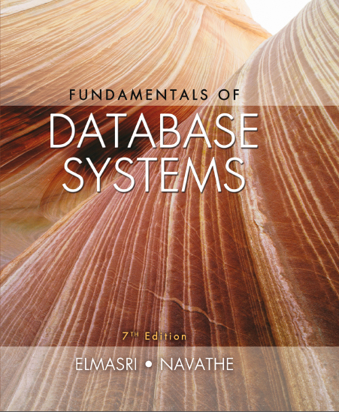
Fundamentals of Database Systems
Seventh Edition
Chapter 28
Data Mining Concepts
Copyright © 2016, 2011, 2007 Pearson Education, Inc. All Rights Reserved
Notes:
If this PowerPoint presentation contains mathematical equations, you may need to check that your computer has the following installed:
1) MathType Plugin
2) Math Player (free versions available)
3) NVDA Reader (free versions available)

Slide 2
Learning Objectives (1 of 2)
28.1 Data Mining
28.1.1 Data Mining vs. Data Warehousing
28.1.2 Knowledge Discovery in Databases (K D D)
28.1.3 Goals of Data Mining and Knowledge Discovery
28.1.4 Types of Knowledge Discovered
28.2 Association Rules
28.2.1 Association Rules Confidence and Support
28.2.2 Apriori Algorithm
28.2.3 Sampling Algorithm
28.2.4 Frequent Pattern (F P) Tree and Growth Algorithms
28.2.5 Partition Algorithm
28.2.6 Other types of Association Rules
28.2.7 Additional Considerations

Slide 3
Learning Objectives (2 of 2)
28.3 Classification
28.4 Clustering
28.5 Other Data Mining Algorithms
28.5.1 Sequential pattern discovery
28.5.2 Time Series Analysis
28.5.3 Regression
28.5.4 Neural Networks
28.5.5 Genetic Algorithms
28.6 Data Mining Applications
28.7 Commercial Data Mining Tools

Slide 4
28.1 Definitions of Data Mining
The discovery of new information in terms of patterns or rules from vast amounts of data.
The process of finding interesting structure in data.
The process of employing one or more computer learning techniques to automatically analyze and extract knowledge from data.

Slide 5
28.1.1 Data Mining versus Data Warehousing
The data warehouse is a historical database designed for decision support.
Data mining can be applied to the data in a warehouse to help with certain types of decisions.
Proper construction of a data warehouse is fundamental to the successful use of data mining.
Most enterprises (Fortune 500 companies) already have data warehouses. They are now trying very hard to benefit from that data with mining techniques.

Slide 6
28.1.2 Knowledge Discovery in Databases (K D D)
Data mining is actually one step of a larger process known as knowledge discovery in databases (K D D).
The K D D process model comprises six phases
Data selection
Data cleansing
Enrichment
Data transformation or encoding
Data mining
Reporting and displaying discovered knowledge

Slide 7
28.1.3 Goals of Data Mining and Knowledge Discovery (P I C O)
Prediction:
Determine how certain attributes will behave in the future.
Identification:
Identify the existence of an item, event, or activity.
Classification:
Partition data into classes or categories.
Optimization:
Optimize the use of limited resources.

Slide 8
28.1.4 Types of Discovered Knowledge
Association Rules
Classification Hierarchies
Sequential Patterns
Patterns Within Time Series
Clustering

Slide 9
28.2 Association Rules
Association rules are frequently used to generate rules from market-basket data.
A market basket corresponds to the sets of items a consumer purchases during one visit to a supermarket.
The set of items purchased by customers is known as an itemset.
An association rule is of the form
are sets of items,
being distinct items for all i and all j.
For an association rule to be of interest, it must satisfy a minimum support and confidence.

Slide 10
28.2.1 Association Rules Confidence and Support
Support:
The minimum percentage of instances in the database that contain all items listed in a given association rule.
Support is the percentage of transactions that contain all of the items in the itemset,
Confidence:
Given a rule of the form
rule confidence is the conditional probability that B is true when A is known to be true.
Confidence can be computed as
support

Slide 11
28.2.2 Generating Association Rules and Apriori Algorithm
The general algorithm for generating association rules is a two-step process.
Generate all itemsets that have a support exceeding the given threshold. Itemsets with this property are called large or frequent itemsets.
Generate rules for each itemset as follows:
For itemset X and Y a subset of X, let Z = X − Y;
If support(X)/Support(Z) > minimum confidence, the rule Z implies Y is a valid rule.

Slide 12
Reducing Association Rule Complexity
Two properties are used to reduce the search space for association rule generation.
Downward Closure
A subset of a large itemset must also be large
Anti-monotonicity
A superset of a small itemset is also small. This implies that the itemset does not have sufficient support to be considered for rule generation.

Slide 13
The Apriori Algorithm (1 of 5)
The Apriori algorithm was the first algorithm used to generate association rules.
The Apriori algorithm uses the general algorithm for creating association rules together with downward closure and anti-monotonicity.

Slide 14


The Apriori Algorithm (2 of 5)
Algorithm 28.1. Apriori Algorithm for Finding Frequent (Large) Itemsets
Input: Database of m transactions, D, and a minimum support, mins, represented as a fraction of m.
Output: Frequent itemsets,
Begin /* steps or statements are numbered for better readability */
Compute support(i _{j}) = count(i _{j})/m for each individual item,
by scanning the database once and counting the number of transactions that item i _{j} appears in (that is, count(i _{j}))

Slide 15


The Apriori Algorithm (3 of 5)
The candidate frequent 1-itemset, C₁, will be the set of items
The subset of items containing i _{j} from C₁ where support(i _{j}) >= mins becomes the frequent 1-itemset, L₁;
k = 1;
termination = false;
repeat
until termination (for this part see the next slide)

Slide 16
The Apriori Algorithm (4 of 5)
repeat
L_{k+1} = (empty set) ;
Create the candidate frequent (k+1)-itemset, C_{k+1}, by combining members of L_{k} that have k–1 items in common (this forms candidate frequent (k+1)-itemsets by selectively extending frequent k-itemsets by one item);
In addition, only consider as elements of C_{k+1} those k+1 items such that every subset of size k appears in L_{k};

Slide 17
The Apriori Algorithm (5 of 5)
Scan the database once and compute the support for each member of C_{k+1}; if the support for a member of C_{k+1} >= mins then add that member to L_{k+1};
If L_{k+1} is empty then termination = true
else k = k + 1;
until termination;
End;

Slide 18
28.2.3 The Sampling Algorithm (1 of 2)
The sampling algorithm selects samples from the database of transactions that individually fit into memory. Frequent itemsets are then formed for each sample.
If the frequent itemsets form a superset of the frequent itemsets for the entire database, then the real frequent itemsets can be obtained by scanning the remainder of the database.
The negative border with respect to a frequent itemset, S, and set of items, I, is the minimal itemsets contained in PowerSet(I) and not in S.

Slide 19
28.2.3 The Sampling Algorithm (2 of 2)
The negative border of a set of frequent itemsets contains the closest itemsets that could also be frequent.
Consider the case where a set X is not contained in the frequent itemsets. If all subsets of X are contained in the set of frequent itemsets, then X would be in the negative border.
If X in the negative border is in the frequent itemsets then there is potential for a superset of X to be in frequent itemsets. In such cases a second pass over the database is needed to make sure all frequent datasets are found.

Slide 20
28.2.4 Frequent-Pattern Tree Algorithm
The Frequent-Pattern Tree Algorithm reduces the total number of candidate itemsets by producing a compressed version of the database in terms of an F P-tree.
The F P-tree stores relevant information and allows for the efficient discovery of frequent itemsets.
The algorithm consists of two steps:
Step 1 builds the F P-tree.
Step 2 uses the tree to find frequent itemsets.

Slide 21
Step 1: Building the F P-Tree (1 of 2)
First, frequent 1-itemsets along with the count of transactions containing each item are computed.
The 1-itemsets are sorted in non-increasing order.
The root of the F P-tree is created with a “null” label.
For each transaction T in the database, place the frequent 1-itemsets in T in sorted order. Designate T as consisting of a head and the remaining items, the tail.
Insert itemset information recursively into the F P-tree as follows:

Slide 22
Step 1: Building the F P-Tree (2 of 2)
Insert itemset information recursively into the F P-tree as follows:
if the current node, N, of the F P-tree has a child with an item name = head, increment the count associated with N by 1 else create a new node, N, with a count of 1, link N to its parent and link N with the item header table.
if tail is nonempty, repeat the above step using only the tail, i.e., the old head is removed and the new head is the first item from the tail and the remaining items become the new tail.

Slide 23
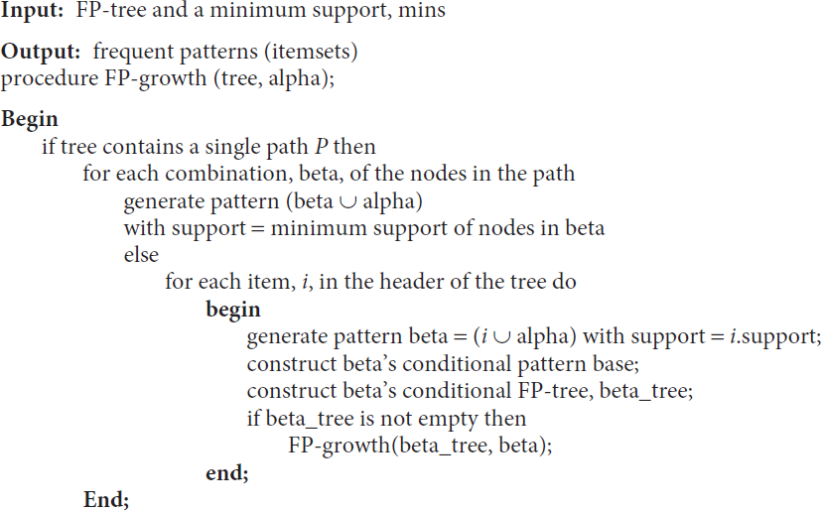
Step 2: The F P-growth Algorithm For Finding Frequent Itemsets

Slide 24
28.2.5 The Partition Algorithm
Divide the database into non-overlapping subsets.
Treat each subset as a separate database where each subset fits entirely into main memory.
Apply the Apriori algorithm to each partition.
Take the union of all frequent itemsets from each partition.
These itemsets form the global candidate frequent itemsets for the entire database.
Verify the global set of itemsets by having their actual support measured for the entire database.

Slide 25
Association Rules among hierarchies (1 of 3)
Certain types of associations occur among hierarchies of items.
For example, foods in a supermarket, items in a department store, or articles in a sports shop can be categorized into classes and subclasses that give rise to hierarchies.
Figure 28.3 shows the taxonomy of items in a supermarket, with two hierarchies—beverages and desserts.

Slide 26
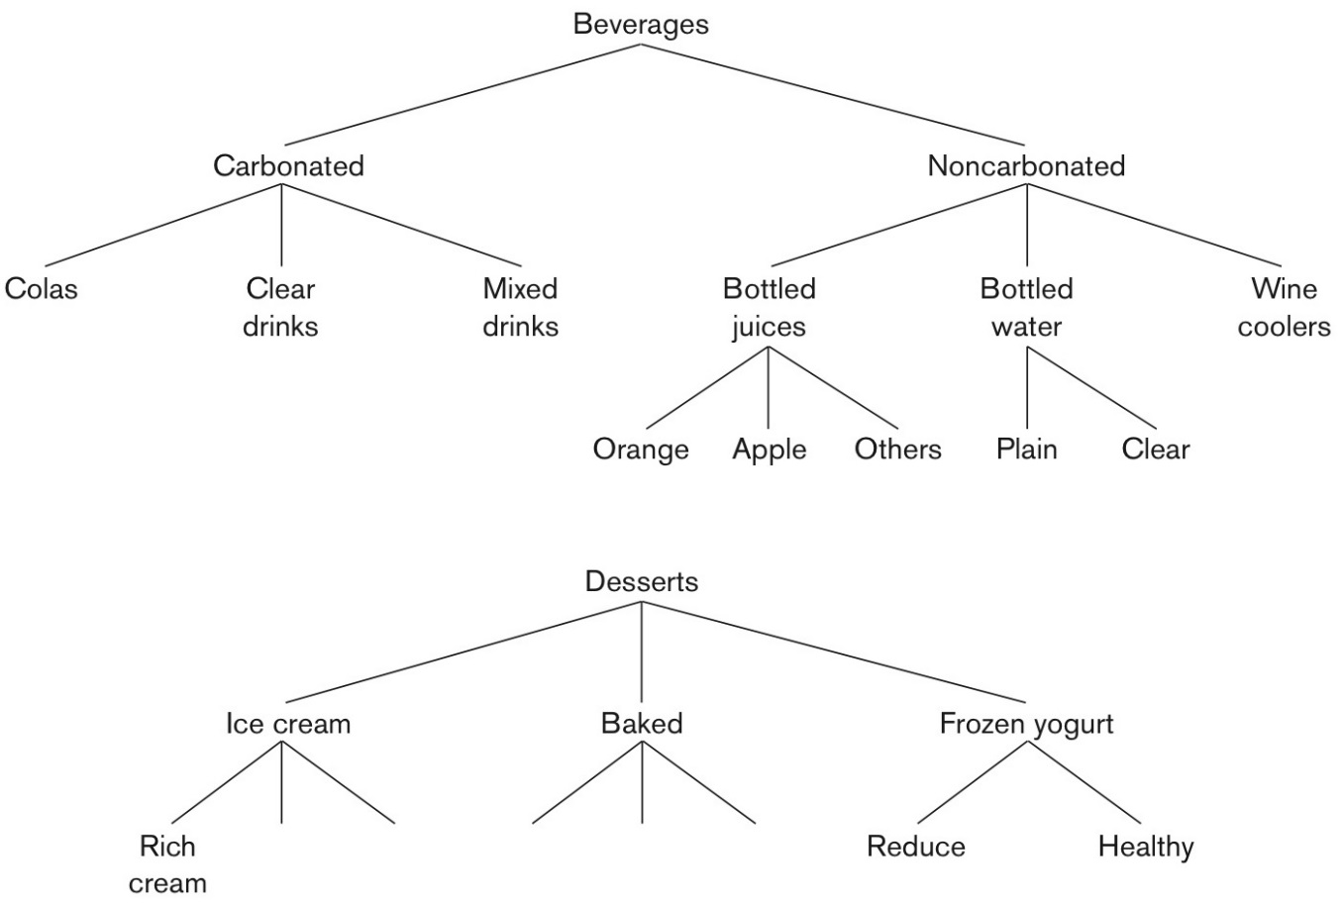
Association Rules among hierarchies (2 of 3)
Figure 28.3 Taxonomy of items in a supermarket.

Slide 27
Association Rules among hierarchies (3 of 3)
The entire groups may not produce associations of the form
beverages implies desserts, or desserts implies beverages.
However, associations of the type
Healthy-brand frozen yogurt implies bottled water, or Rich cream-brand ice cream implies wine cooler
may produce enough confidence and support to be valid association rules.

Slide 28
Multi-dimensional Association Rules
The following rule is an example of including the label of the single dimension:
Items_bought(milk) implies Items_bought(juice).
It may be of interest to find association rules that involve multiple dimensions, for example,
Time(6:30...8:00) implies Items_bought(milk).
Rules like these are called multidimensional association rules. The dimensions represent attributes of records of a file or, in terms of relations, columns of rows of a relation, and can be categorical or quantitative

Slide 29
Multi-dimensional and Negative Association Rules
One approach to handling a quantitative attribute is to partition its values into non-overlapping intervals.
E.g., consider the salary attribute:
(0 < Salary < 29,999 ) implies {Kia, Hyundai}
(30,000 < salary < 99,999) implies {Honda, Toyota}
(100,000 < salary < 149,000) implies {Lexus, Mercedes}
(150,000 < salary < 300,000) implies {Porsche, BMW}
Negative Association Rules: E.g.. those who buy
Soft_drink “Wakeup” are not likely to buy chips “Nightos”. It is very difficult to discover these because support is very low by definition. See the discussion in the text and
Savasere, Omiecinski and Navathe, “Mining Strong Negative Association in a Large Database of Customer Transactions,” Int. Conf. on Data Mining, 1998.

Slide 30
Complications seen with Association Rules
The cardinality of itemsets in most situations is extremely large.
Association rule mining is more difficult when transactions show variability in factors such as geographic location and seasons.
Item classifications exist along multiple dimensions. Those must be taken into account.
Data quality is variable; data may be missing, erroneous, conflicting, as well as redundant.

Slide 31
28.3 Classification
Classification is the process of learning a model that is able to describe different classes of data.
Learning is supervised as the classes to be learned are predetermined.
Learning is accomplished by using a training set of pre-classified data.
The model produced is usually in the form of a decision tree or a set of rules.

Slide 32

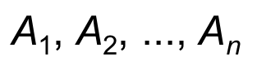
Decision Tree Construction (1 of 2)
Algorithm 28.3. Algorithm for Decision Tree Induction
Input: Set of training data records:
and set of attributes:
Output: Decision tree
procedure Build_tree (records, attributes);

Slide 33
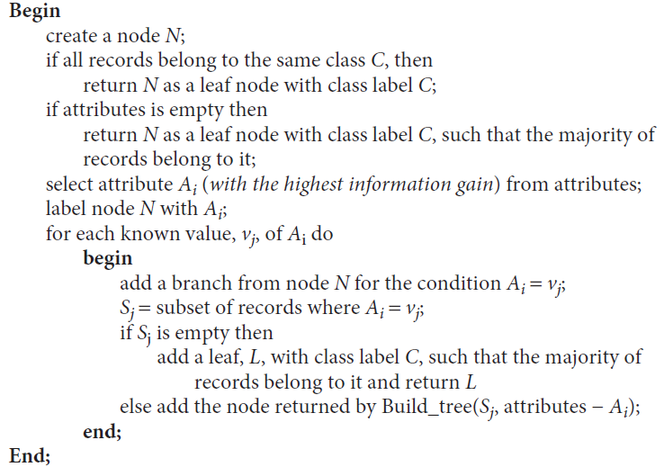
Decision Tree Construction (2 of 2)

Slide 34
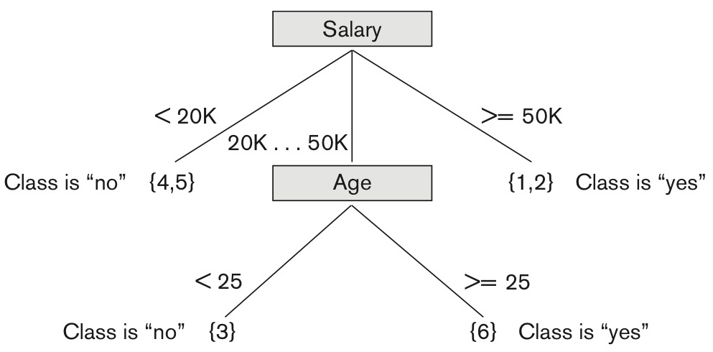
Figure 28.7 Decision tree based on sample training data
Where the leaf nodes are represented by a set of R I D s of the partitioned records.

Slide 35
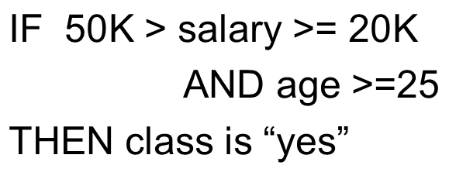
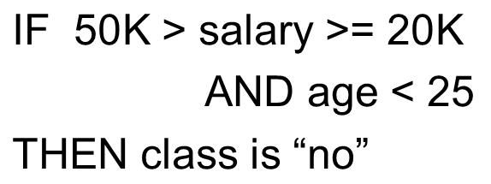
An Example Rule
Here is one of the rules extracted from the decision tree of Figure 28.7.
Another rule

Slide 36
28.4 Clustering
Unsupervised learning or clustering builds models from data without predefined classes.
The goal is to place records into groups where the records in a group are highly similar to each other and dissimilar to records in other groups.
The k-Means algorithm is a simple yet effective clustering technique.

Slide 37
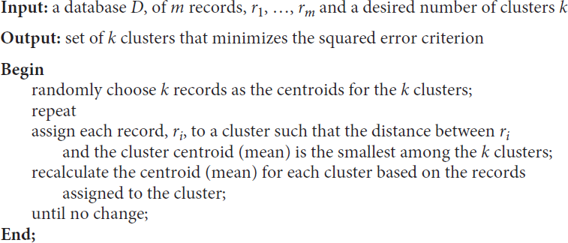
K-Means Clustering
Algorithm 28.4. k-Means Clustering Algorithm

Slide 38
28.5 Additional Approaches for Data Mining
Sequential pattern analysis
Looks for a sequence of itemsets
Transactions ordered by time of purchase form a sequence of itemsets.
The support for a sequence S of itemsets is the percentage of the given set U of sequences of which S is a subsequence
Assuming we are analyzing sequences of items as a time series for a customer, The sequence S₁, S₂, S₃, ... is a predictor of the fact that a customer who buys itemset S₁ is likely to buy itemset S₂ and then S₃, and so on.

Slide 39
28.5.2 Time Series Analysis
Time Series analysis
Time series are sequences of events; each event may be a given fixed type of a transaction.
For example, the closing price of a stock or a fund is an event that occurs every weekday for each stock and fund. The sequence of these values per stock or fund constitutes a time series.
For a time series, one may look for a variety of patterns by analyzing sequences and subsequences as we did above
Time series may be compared by establishing measures of similarity to identify companies whose stocks behave in a similar fashion
Time series analysis is an extended functionality of temporal data management.

Slide 40
28.5.3 Regression (1 of 2)
Regression
Regression is a special application of the classification rule.
If a classification rule is regarded as a function over the variables that maps these variables into a target class variable, the rule is called a regression rule.
A regression equation (or function) estimates a dependent variable using a set of independent variables and a set of constants.
For example, consider a relation n
LAB_TESTS (patient I D, test 1, test 2, ..., test n)
which contains values that are results from a series of n tests for one patient.
The target variable that we wish to predict is P, the probability of survival of the patient. Then the rule for regression takes the form:

Slide 41
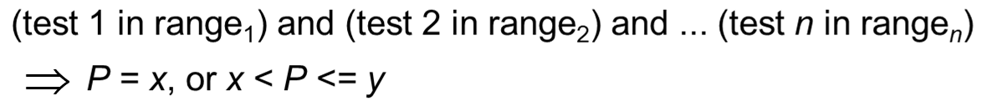



28.5.3 Regression (2 of 2)
Regression
In the above example, we regard P as a function:
If the function appears as
and f is linear in the domain variables x_{i}, the process of deriving f from a given set of tuples for
is called linear regression.
Linear regression is a commonly used statistical technique for fitting a set of observations or points in n dimensions with the target variable y.

Slide 42
28.5.4 Neural Networks (1 of 2)
A Neural Network is a set of interconnected nodes designed to imitate the functioning of the brain.
Node connections have weights which are modified during the learning process.
Neural networks are of two types: supervised and unsupervised.
Adaptive methods that attempt to reduce the output error are supervised learning methods

Slide 43
28.5.4 Neural Networks (2 of 2)
Those that develop internal representations without sample outputs are called unsupervised learning methods.
The output of a supervised neural network is quantitative and not easily understood.
Unsupervised networks learn; but they do not provide a good representation of what they learn
Although neural networks suffer from above shortcomings and cannot easily deal with time series data, they are still popular.

Slide 44
28.5.5 Genetic Algorithms (1 of 2)
Genetic algorithms (G A s) are a class of randomized search procedures capable of adaptive and robust search over a wide range of search space topologies.
Modeled after the adaptive emergence of biological species from evolutionary mechanisms, Genetic learning is based on the theory of evolution.
An initial population of several candidate solutions is provided to the learning model.
A fitness function defines which solutions survive from one generation to the next.
Crossover, mutation and selection are used to create new population elements.

Slide 45
28.5.5 Genetic Algorithms (2 of 2)
The solutions produced by G A s are distinguished from most other search techniques by the following characteristics:
A G A search uses a set of solutions during each generation rather than a single solution.
The search in the string-space represents a much larger parallel search in the space of encoded solutions.
The memory of the search done is represented solely by the set of solutions available for a generation.
A genetic algorithm is a randomized algorithm since search mechanisms use probabilistic operators.
While progressing from one generation to the next, a G A finds near-optimal balance between knowledge acquisition and exploitation by manipulating encoded solutions.

Slide 46
28.6 Data Mining / Business Analytics (B.I.) Applications
Marketing
Marketing strategies and consumer behavior. Advertising, Service location, Customer Segmentation, Targeted mailing
Finance
Fraud detection, creditworthiness and investment performance analysis
Manufacturing
Resource optimization of men, machines and materials
Health
Image analysis, genetic analysis, side effects of drug, and treatment effectiveness, process and cost optimization in healthcare services

Slide 47
28.7 Data Mining Tools
Currently, commercial data mining tools use several common techniques to extract knowledge. These include association rules, clustering, neural networks, sequencing, and statistical analysis.
Also used are decision trees, which are a representation of the rules used in classification or clustering, and statistical analyses, which may include different types of regression and many other techniques.
Some commercial products use advanced techniques such as genetic algorithms, case-based reasoning, Bayesian networks, nonlinear regression, combinatorial optimization, pattern matching, and fuzzy logic.
A set of representative tools are presented in Table 28.2

Slide 48
Some Commercial Data Mining Tools (1 of 2)
Table 28.1 Some Representative Data Mining Tools
Company | Product | Technique | Platform | Interface*
I B M | Intelligent Miner | I B M Intelligent Miner Classification, association rules, predictive models | UNIX (A I X) | I B M D B 2
Megaputer Intelligence | PolyAnalyst | Symbolic knowledge acquisition, evolutionary programming | Windows O S/2 | O D B C Oracle D B 2
N C R | Management Discovery Tool (M D T) | Association rules | Windows | O D B C
Purple Insight | MineSet | Decision trees, association rules | UNIX (Irix) | Oracle Sybase Informix
S A S | Enterprise Miner | Decision trees, association rules, Nneural nets, regression, clustering | UNIX (Solaris) Windows Macintosh | O D B C Oracle A S/400
*O D B C: Open Database Connectivity
O D M G: Object Data Management Group

Slide 49
Future of Data Mining
Data mining tools are continually evolving, building on ideas from the latest scientific research.
Many of these tools incorporate the latest algorithms taken from artificial intelligence (A I), machine learning (which is a very parallel term), statistics, and optimization.
The primary direction for data mining is to analyze terabytes and petabytes of data in the so-called Big Data systems which we presented in Chapter 25.
Big Data systems are being equipped with their own tools and libraries for data mining such as Mahout which runs on top of Hadoop.
The data mining area will also be closely tied to data that will be housed in the cloud in data warehouses and brought into service for mining operations as needed using O L A P (Online Analytical Processing) servers.
Business Analytics is the primary goal of the currently advancing Spark technology.

Slide 50
Recap (1 of 2)
Data Mining
Data Warehousing
Knowledge Discovery in Databases (K D D)
Goals of Data Mining and Knowledge Discovery
Association Rules
Classification

Slide 51
Recap (2 of 2)
Clusering
Additional Data Mining Algorithms
Sequential pattern analysis
Time Series Analysis
Regression
Neural Networks
Genetic Algorithms
Data Mining Applications
Commercial Data Mining Tools and Future Directions.

Slide 52

Copyright

